Slide 1

PROJECT WORK-II
PRESENTED BY-
PRANAY GARG
[EN18CS301175]
PRESENTED TO-
Dr. KAILASH BANDHU
Mr. BINOD K MISHRA

Slide 2
Company Profile (QC Trip LLP)
QC TRIP is a travel management company based in Guwahati, Assam.
Qc trip aims to provide the best service at best price.
The main focus of the QC TRIP is to enhance the booking and travel experience through affordable pricing and complementary services.
We can use QC TRIP on the web portal as well as on its application.

Slide 3
Abstract
Almost people love to travel from one place to another.
Need for the tourism management that can manage tourism information.
Dynamic website for tourism business.
Designed for travel agencies for managing tour packages.
Updating and upgrading of tour packages.
Customer can find right tour under budget.
Secure, reliable and fast management .

Slide 4
Introduction
Project used to automate all process of travel and tourism.
Book the tour from anywhere in world with single dynamic website.
Easiest platform allow user to access all details such as locations, events.
Convenience and secure way of travelling.
With e-ticketing ,all associated information stored digitally.
Enables all travel related information operations .

Slide 5
Domain
Web Development : Web development is the work involved in developing a website for the Internet or an intranet. Web development can range from developing a simple single static page of plain text to complex web applications, electronic businesses, and social network services.
Front-end web development is responsible for the look and feel of a website. This means how colors, type, icons, and images appear. Increasingly, front-end development has to account for how a website looks on all devices, from desktop to tablet to phone. Typical programming languages include HTML, JavaScript, and CSS.

Slide 6
Domain
Back-end web development is responsible for building and maintaining the code that runs a website. This code connects the website to the server and ensures that data flows properly to the website and that transactions are processed correctly. Typical programming languages include Java, PHP, and MySQL; newer tools include Python and Golang.
Full-stack web development covers both front-end and back-end responsibilities. Depending on the complexity of a website, a full-stack developer may be responsible for all facets of its development, from the server side to the user interface.

Slide 7
HTML
HTML stands for Hyper Text Markup Language
HTML is the standard markup language for creating Web pages
HTML describes the structure of a Web page
HTML consists of a series of elements
HTML elements tell the browser how to display the content
HTML elements label pieces of content such as "this is a heading", "this is a paragraph", "this is a link", etc.

Slide 8
CSS
CSS stands for Cascading Style Sheets
CSS describes how HTML elements are to be displayed on screen, paper, or in other media
CSS saves a lot of work. It can control the layout of multiple web pages all at once
External stylesheets are stored in CSS files
CSS is used to define styles for your web pages, including the design, layout and variations in display for different devices and screen sizes.

Slide 9
Javascript
JavaScript, often abbreviated JS, is a programming language that is one of the core technologies of the World Wide Web, alongside HTML and CSS. Over 97% of websites use JavaScript on the client side for web page behavior, often incorporating third-party libraries.
Light weight scripting language
Object oriented programming support
Platform independent
Interpreted language

Slide 10
Bootstrap
Bootstrap is a free and open-source CSS framework directed at responsive, mobile-first front-end web development. It contains CSS and JavaScript-based design templates for typography, forms, buttons, navigation, and other interface components.
Bootstrap 5 is the newest version of Bootstrap; with new components, faster stylesheets, more responsiveness etc. It supports the latest, stable releases of all major browsers and platforms. However, Internet Explorer 11 and down is not supported.

Slide 11
SQL
SQL stands for Structured Query Language standard language for storing, manipulating and retrieving data in databases
These SQL commands are mainly categorized into four categories as:
DDL – Data Definition Language : It simply deals with descriptions of the database schema and is used to create and modify the structure of database objects in the database. DDL is a set of SQL commands used to create, modify, and delete database structures but not data.
DQl – Data Query Language : The purpose of the DQL Command is to get some schema relation based on the query passed to it. It includes the SELECT statement.
DML – Data Manipulation Language : It is the component of the SQL statement that controls access to data and to the database.
DCL – Data Control Language : DCL includes commands such as GRANT and REVOKE which mainly deal with the rights, permissions, and other controls of the database system.

Slide 12
System Domain
Programming language : PHP
Database : MYSQL
User interface design :
HTML - Hypertext Markup language.
CSS - Cascading Style Sheets.
Bootstrap – free and open-source CSS framework.
JavaScript – high level often just-in-one time compiled.
jQuery – JavaScript library.
Tools used : XAMPP , Visual studio code.

Slide 13
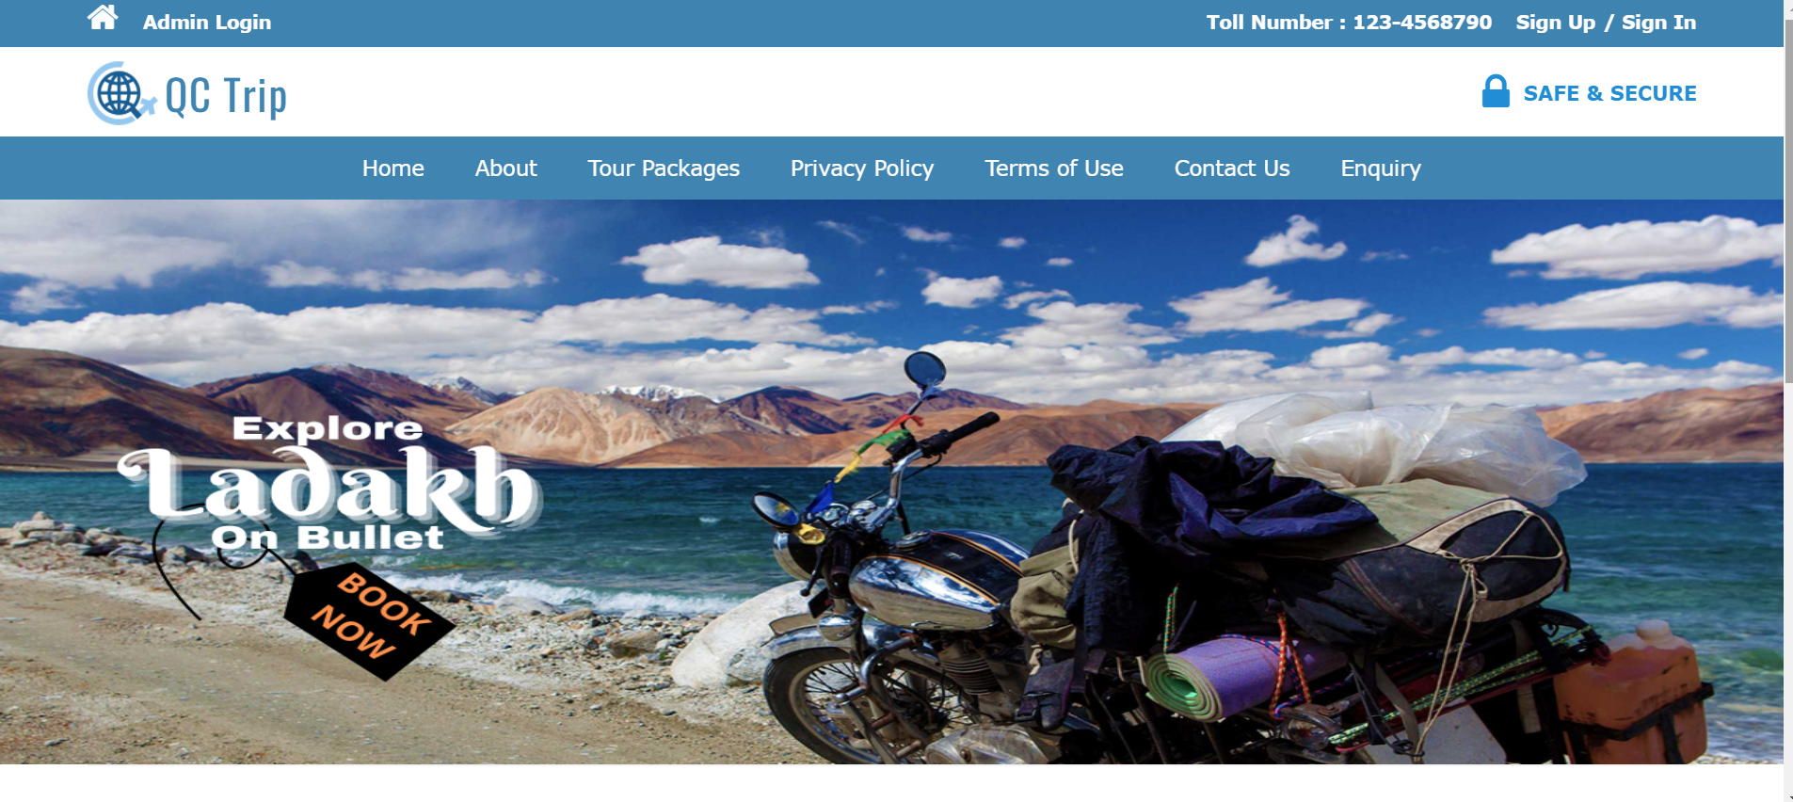
IMPLEMENTATION

Slide 14
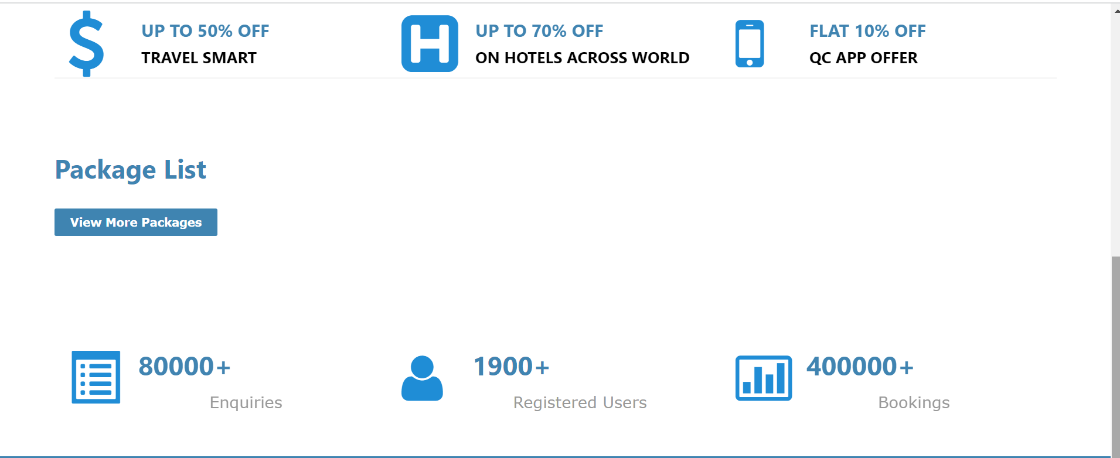
IMPLEMENTATION

Slide 15
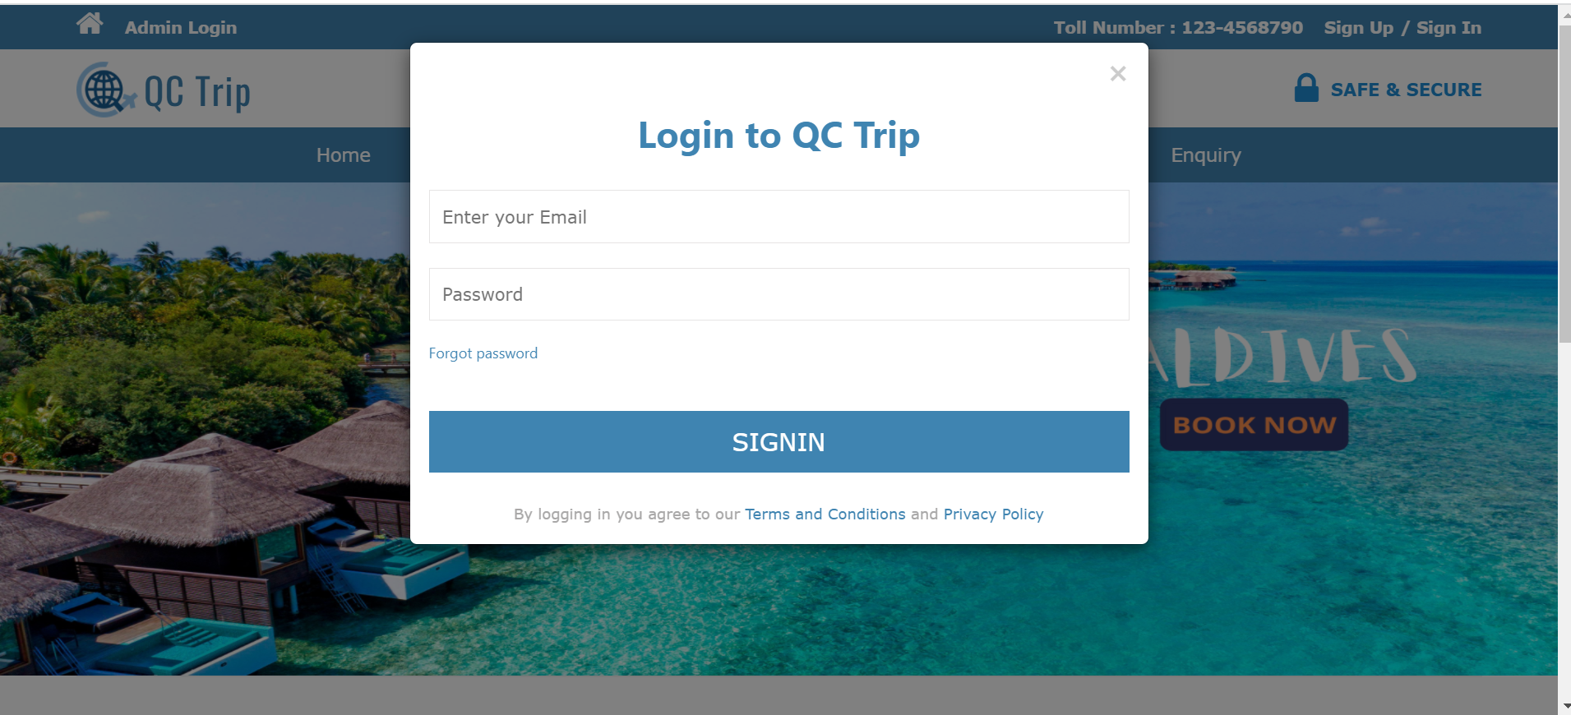
IMPLEMENTATION

Slide 16
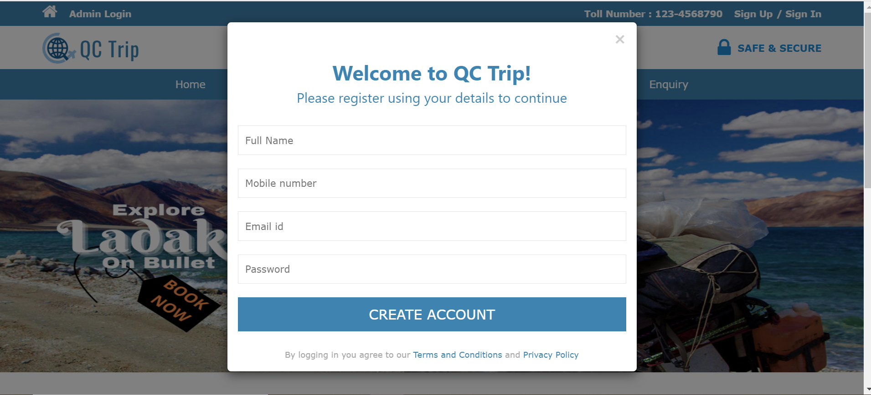
IMPLEMENTATION

Slide 17
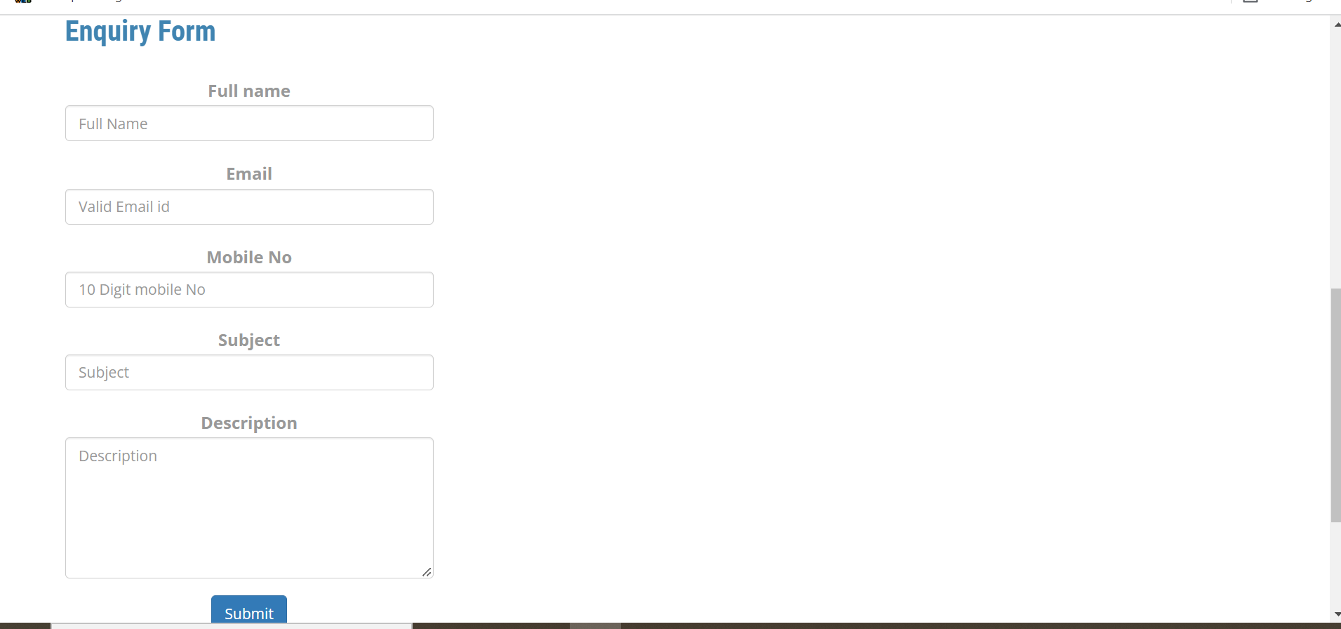
IMPLEMENTATION

Slide 18
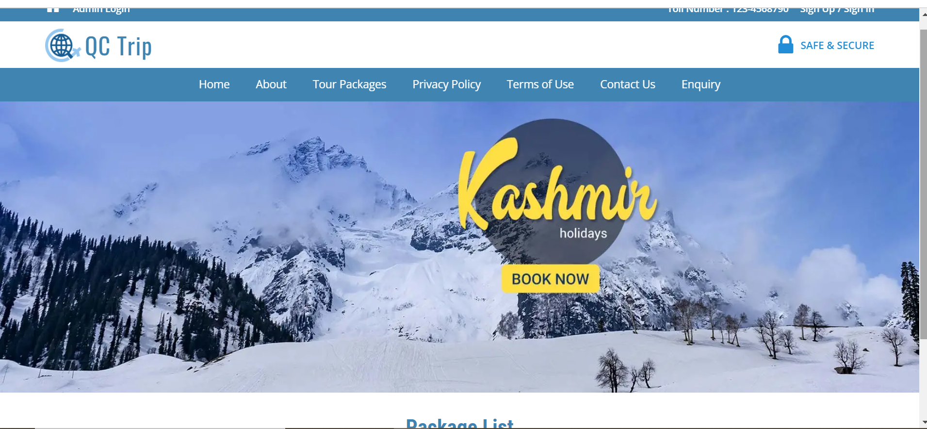
IMPLEMENTATION

Slide 19
THANK YOU

